Slide 1
R programming

Slide 2
Outline
Operators
Loops
Functions
The apply family (lapply, sapply)
Utilities

Slide 3
Operators

Slide 4
Equality
# Comparison of logicals
TRUE == FALSE
# Comparison of numerics
-6 * 14 != 17 - 101
# Comparison of character strings
"useR" == "user"
# Compare a logical with a numeric
TRUE == 1

Slide 5
Compare vectors
# The linkedin and facebook vectors have already been created for you
linkedin <- c(16, 9, 13, 5, 2, 17, 14)
facebook <- c(17, 7, 5, 16, 8, 13, 14)
# Popular days
linkedin > 15
# Quiet days
linkedin <= 5
# LinkedIn more popular than Facebook
linkedin > facebook

Slide 6
Compare matrices
# The social data has been created for you
linkedin <- c(16, 9, 13, 5, 2, 17, 14)
facebook <- c(17, 7, 5, 16, 8, 13, 14)
views <- matrix(c(linkedin, facebook), nrow = 2, byrow = TRUE)
# When does views equal 13?
views == 13
# When is views less than or equal to 14?
views <= 14

Slide 7
& and |
# The linkedin and last variable are already defined for you
linkedin <- c(16, 9, 13, 5, 2, 17, 14)
last <- tail(linkedin, 1)
# Is last under 5 or above 10?
last < 5 | last > 10
# Is last between 15 (exclusive) and 20 (inclusive)?
last > 15 & last <= 20

Slide 8
if statement
medium <- "LinkedIn"
num_views <- 14
if (medium == "LinkedIn") {
print("Showing LinkedIn information")
}
if (num_views > 15) {
print("You're popular!")
} else if (num_views <= 15 & num_views > 10) {
print("10~15")
} else {
print("Try to be more visible!")
}

Slide 9
While loop
speed <- 64
while (speed > 30) {
print("Slow down!")
speed <- speed - 7
}
speed

Slide 10
While loop (break)
speed <- 88
while (speed > 30) {
print(paste("Your speed is", speed))
speed <- speed+10
if (speed > 120) {
break
}
}

Slide 11
For loop (vector)
linkedin <- c(16, 9, 13, 5, 2, 17, 14)
# Loop version 1
for (eachElement in linkedin) {
print(eachElement)
}
# Loop version 2
for (i in 1:length(linkedin)) {
print(linkedin[i])
}

Slide 12
For loop (list)
nyc <- list(pop = 8405837,
boroughs = c("Manhattan", "Bronx", "Brooklyn", "Queens", "Staten Island"),
capital = FALSE)
# Loop version 1
for (info in nyc) {
print(info)
}
# Loop version 2
for (i in 1:length(nyc)) {
print(nyc[[i]])
}

Slide 13
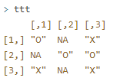
For loop (matrix)
ttt
for (i in 1:nrow(ttt)) {
for (j in 1:ncol(ttt)) {
print(paste("On row", i,
"and column", j,
"the board contains", ttt[i,j]))
}
}

Slide 14
Functions
呼叫 Function
自建 Function

Slide 15
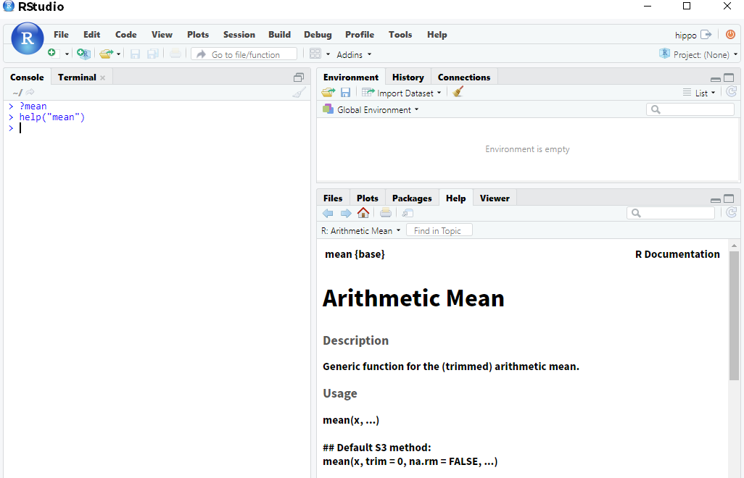
呼叫 function 說明
?functionName
help(functionName)
linkedin <- c(16, 9, 13, 5, 2, 17, 14)
avg_li <- mean(x = linkedin)
avg_li

Slide 16
忽略 NA
linkedin <- c(16, 9, 13, 5, NA, 17, 14)
mean(linkedin)
mean(linkedin, na.rm = TRUE)

Slide 17
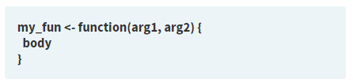
自建 Function
# Create a function pow_two()
pow_two <- function(x) {
x ^ 2
}
pow_two(12)
# Create a function sum_abs()
sum_abs <- function(x, y) {
abs(x) + abs(y)
}
sum_abs(-2, 3)

Slide 18
觀察下面三個執行結果
# Finish the pow_two() function
pow_two <- function(x, print_info = TRUE) {
y <- x ^ 2
if (print_info) {
print(paste(x, "to the power two equals", y))
}
return(y)
}
pow_two(5)
pow_two(5, FALSE)
pow_two(5, TRUE)

Slide 19
R Package

Slide 20
install.packages(), which as you can expect, installs a given package.
library() which loads packages, i.e. attaches them to the search list on your R workspace.
# Load the ggplot2 package
library("ggplot2")
# Retry the qplot() function
qplot(mtcars$wt, mtcars$hp)

Slide 21
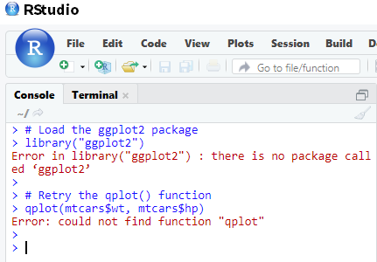
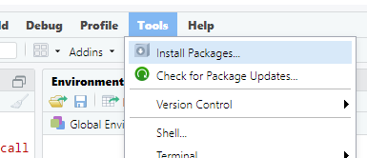


Slide 22
lapply

Slide 23
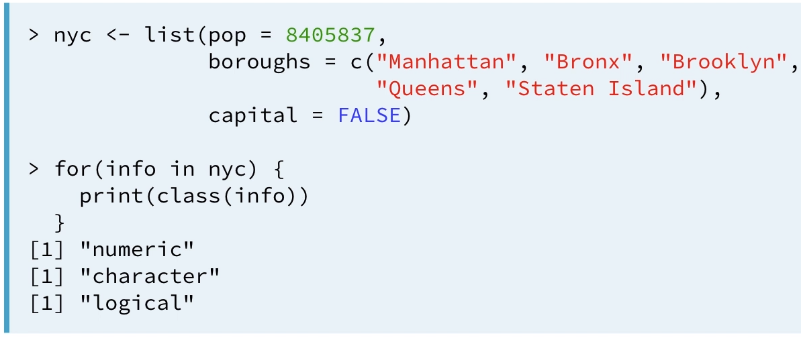
Example 1: 找出元素的型態 (for loop)

Slide 24
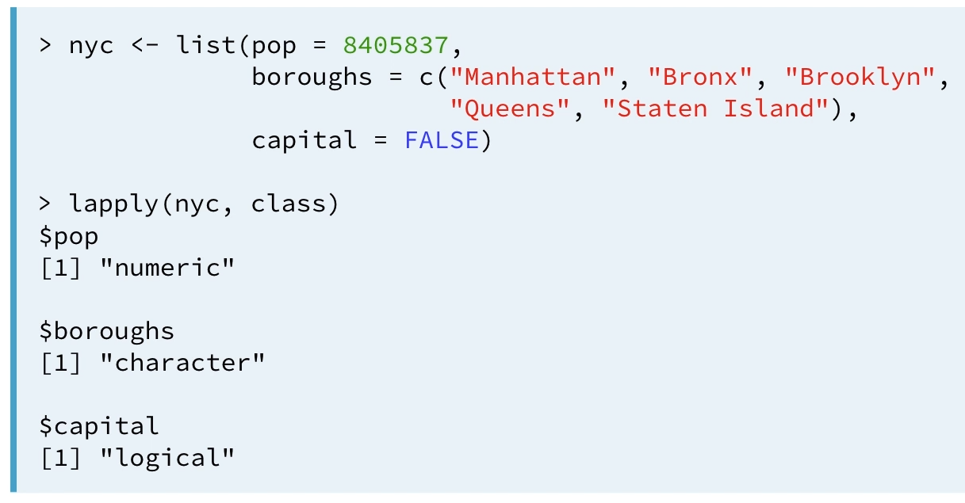
Example 1: 找出元素的型態 (lapply)

Slide 25
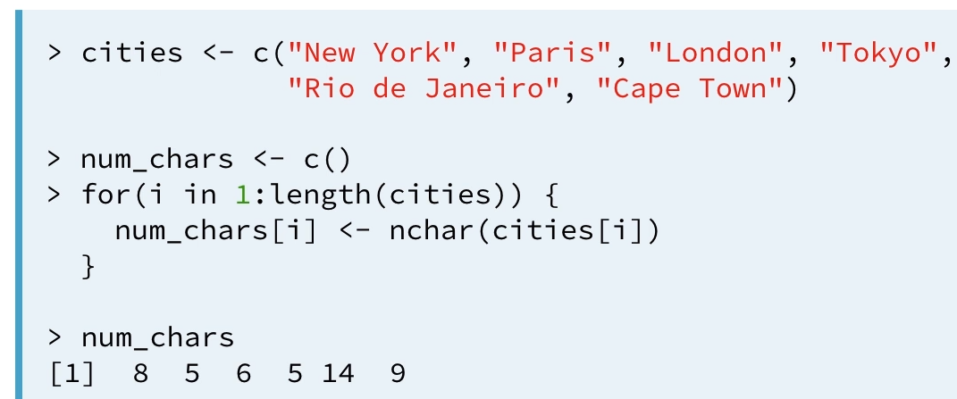
Example 2: 找出字串長度 (for loop)

Slide 26
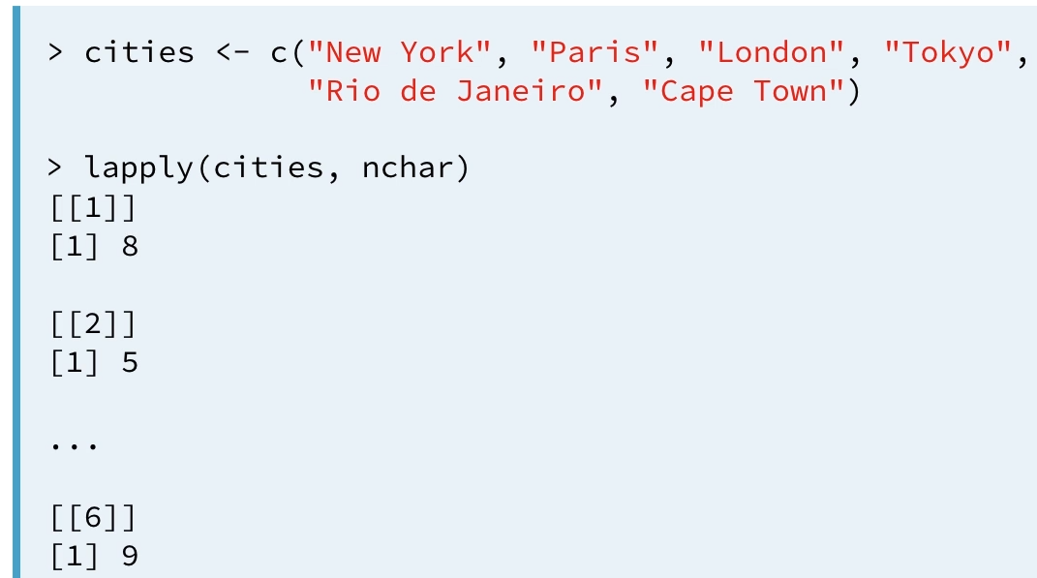

Example 2: 找出字串長度 (lapply)

Slide 27
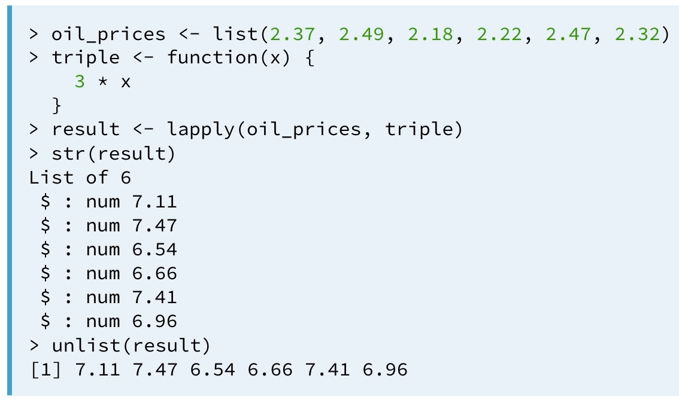
Example 3: 自訂function

Slide 28
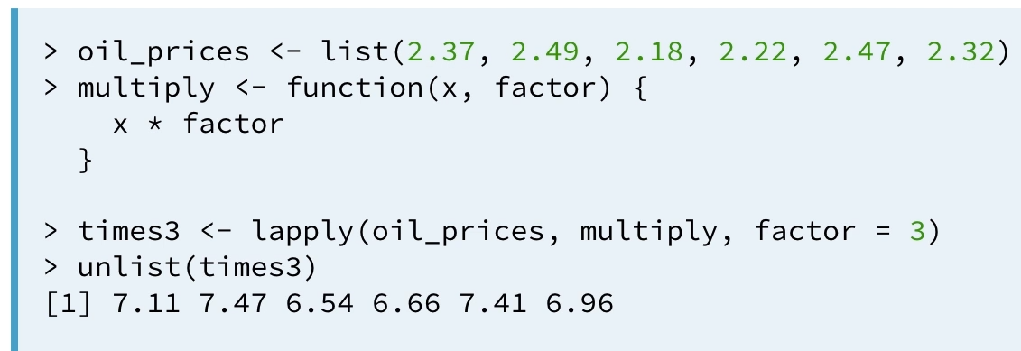
Example 4: 自訂function + 參數傳遞

Slide 29

Anonymous functions
# Definition of split_low
pioneers <- c("GAUSS:1777", "BAYES:1702", "PASCAL:1623", "PEARSON:1857")
split <- strsplit(pioneers, split = ":")
# Transform: use anonymous function inside lapply
names <- lapply(split, function(x) { x[1] })
names

Slide 30
sapply

Slide 31
lapply vs sapply
temp <- c(10,20,30,40,50)
lapply(temp, function(x){x*2})
sapply(temp, function(x){x*2})

Slide 32
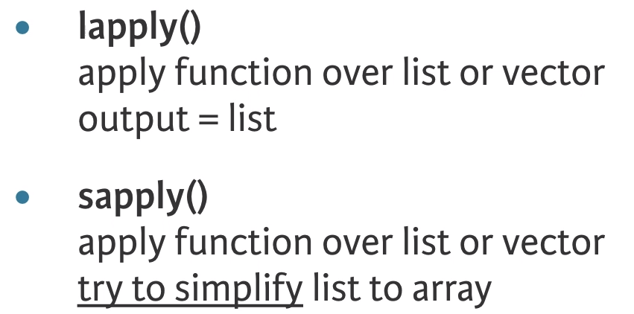
lapply vs sapply

Slide 33
Useful Functions

Slide 34
Mathematical utilities
abs(): Calculate the absolute value.
sum(): Calculate the sum of all the values in a data structure.
mean(): Calculate the arithmetic mean.
round(): Round the values to 0 decimal places by default.
data <- c(1.9, -2.6, 4.0, -9.5, -3.4, 7.3)
sum(abs(round(data)))

Slide 35
Data Utilities
seq(): Generate sequences, by specifying the from, to, and by arguments.
rep(): Replicate elements of vectors and lists.
sort(): Sort a vector in ascending order. Works on numerics, but also on character strings and logicals.
rev(): Reverse the elements in a data structures for which reversal is defined.
str(): Display the structure of any R object.
append(): Merge vectors or lists.
is.*(): Check for the class of an R object.
as.*(): Convert an R object from one class to another.
unlist(): Flatten (possibly embedded) lists to produce a vector.

Slide 36
linkedin <- list(16, 9, 13, 5, 2, 17, 14)
facebook <- list(17, 7, 5, 16, 8, 13, 14)
# Convert linkedin and facebook to a vector: li_vec and fb_vec
li_vec <- unlist(linkedin)
fb_vec <- unlist(facebook)
# Append fb_vec to li_vec: social_vec
social_vec <- append(li_vec, fb_vec)
# Sort social_vec
sort(social_vec, decreasing = TRUE)

Slide 37
Try it…
rep(seq(1, 7, by = 2), times = 7)

Slide 38
Try to fix the error
vec1 <- c(1.5, 2.5, 8.4, 3.7, 6.3)
vec2 <- rev(vec1)
mean(abs(vec1), abs(vec2))
Notes:
mean(c(abs(vec1), abs(vec2)))

Slide 39
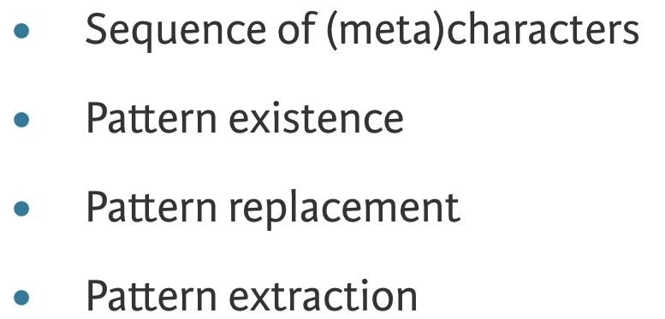
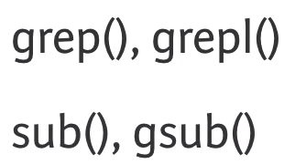
Regular Expressions

Slide 40
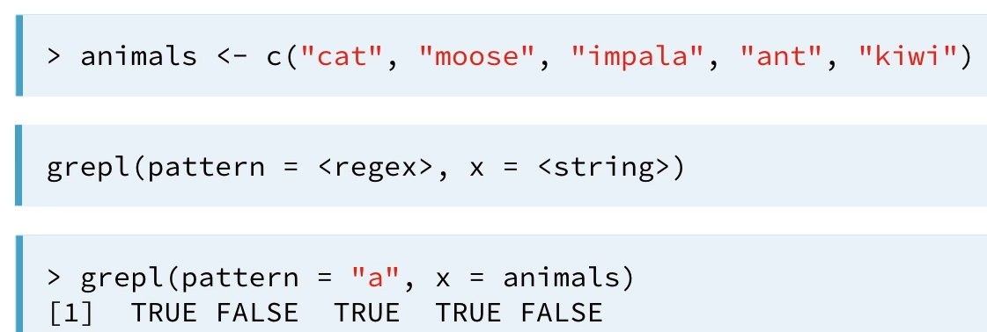
字串尋找: grepl()
a 在字首
a 在字尾

Slide 41
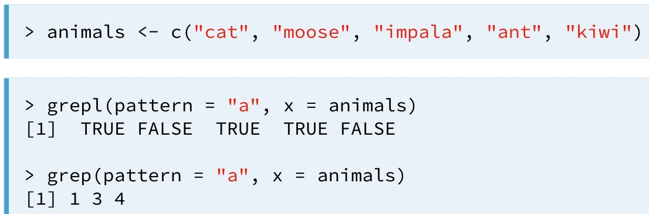
字串尋找: grep() vs grepl()

Slide 42
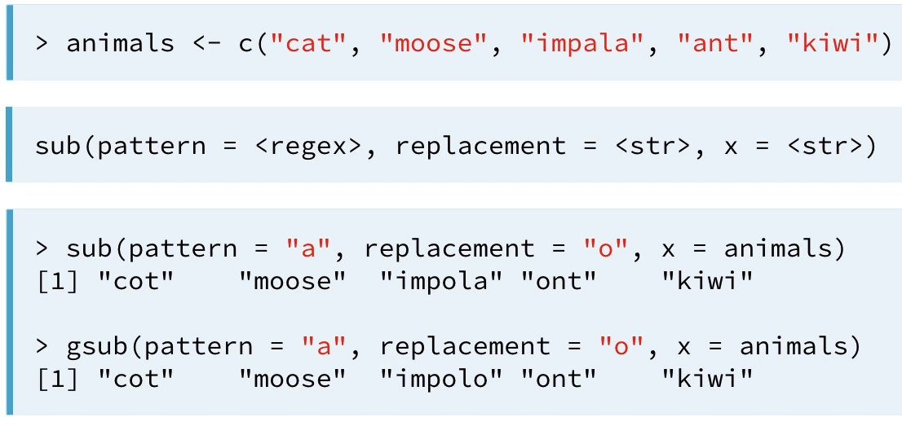
字串取代: sub() vs gsub()

Slide 43
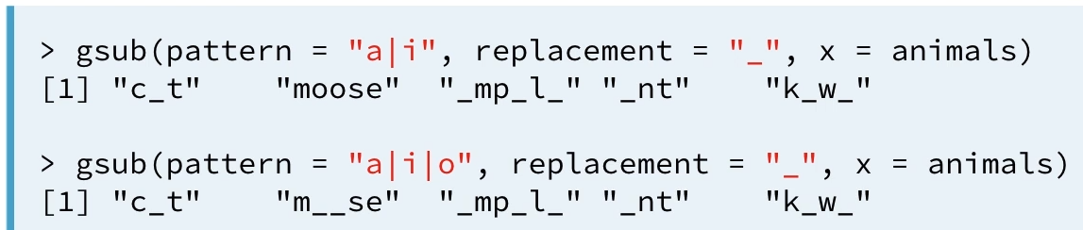
“|” 或

Slide 44
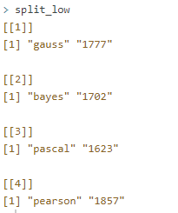
請利用 strsplit, tolower, lapply 完成下面的輸出
今日點名:
pioneers <- c("GAUSS:1777", "BAYES:1702", "PASCAL:1623", "PEARSON:1857")
PS. 利用 : 分隔 名子與字串，再利用 tolower 把字串轉成小寫

Slide 45
Date & Time

Slide 46
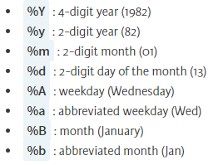
Date
# Definition of character strings representing dates
str1 <- "May 23, '96"
str2 <- "2012-03-15"
str3 <- "30/January/2006"
# Convert the strings to dates: date1, date2, date3
date1 <- as.Date(str1, format = "%b %d, '%y")
date2 <- as.Date(str2)
date3 <- as.Date(str3, format = "%d/%B/%Y")
# Convert dates to formatted strings
format(date1, "%A")
format(date2, "%d")
format(date3, "%b %Y")

Slide 47
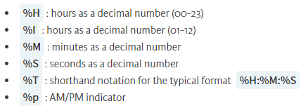
Time
# Definition of character strings representing times
str1 <- "May 23, '96 hours:23 minutes:01 seconds:45"
str2 <- "2012-3-12 14:23:08"
# Convert the strings to POSIXct objects: time1, time2
time1 <- as.POSIXct(str1, format = "%B %d, '%y hours:%H minutes:%M seconds:%S")
time2 <- as.POSIXct(str2)
# Convert times to formatted strings
format(time1, "%M")
format(time2, "%I:%M %p")

Slide 48
Calculations with Dates
today <- Sys.Date()
today + 1
today - 1
as.Date("2015-03-12") - as.Date("2015-02-27")

Slide 49
Calculations with Times
now <- Sys.time()
now + 3600 # add an hour
now - 3600 * 24 # subtract a day
start <- as.POSIXct("1879-03-14 14:37:23")
end <- as.POSIXct("1955-04-18 03:47:12")
ans <- end - start
ans

